Slide 1

Now that you have learned the forms of the preterite and the imperfect, you will learn more about how they are used. The preterite and the imperfect are not interchangeable. In Spanish, the choice between these two tenses depends on the context and on the point of view of the speaker.
© by Vista Higher Learning, Inc. All rights reserved.
1.2-<number>

Slide 2
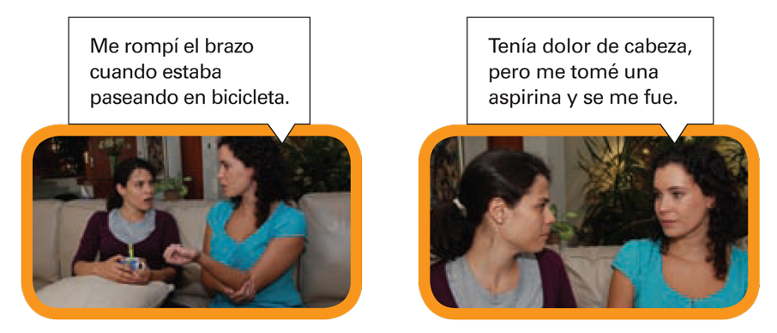
© by Vista Higher Learning, Inc. All rights reserved.
1.2-<number>

Slide 3
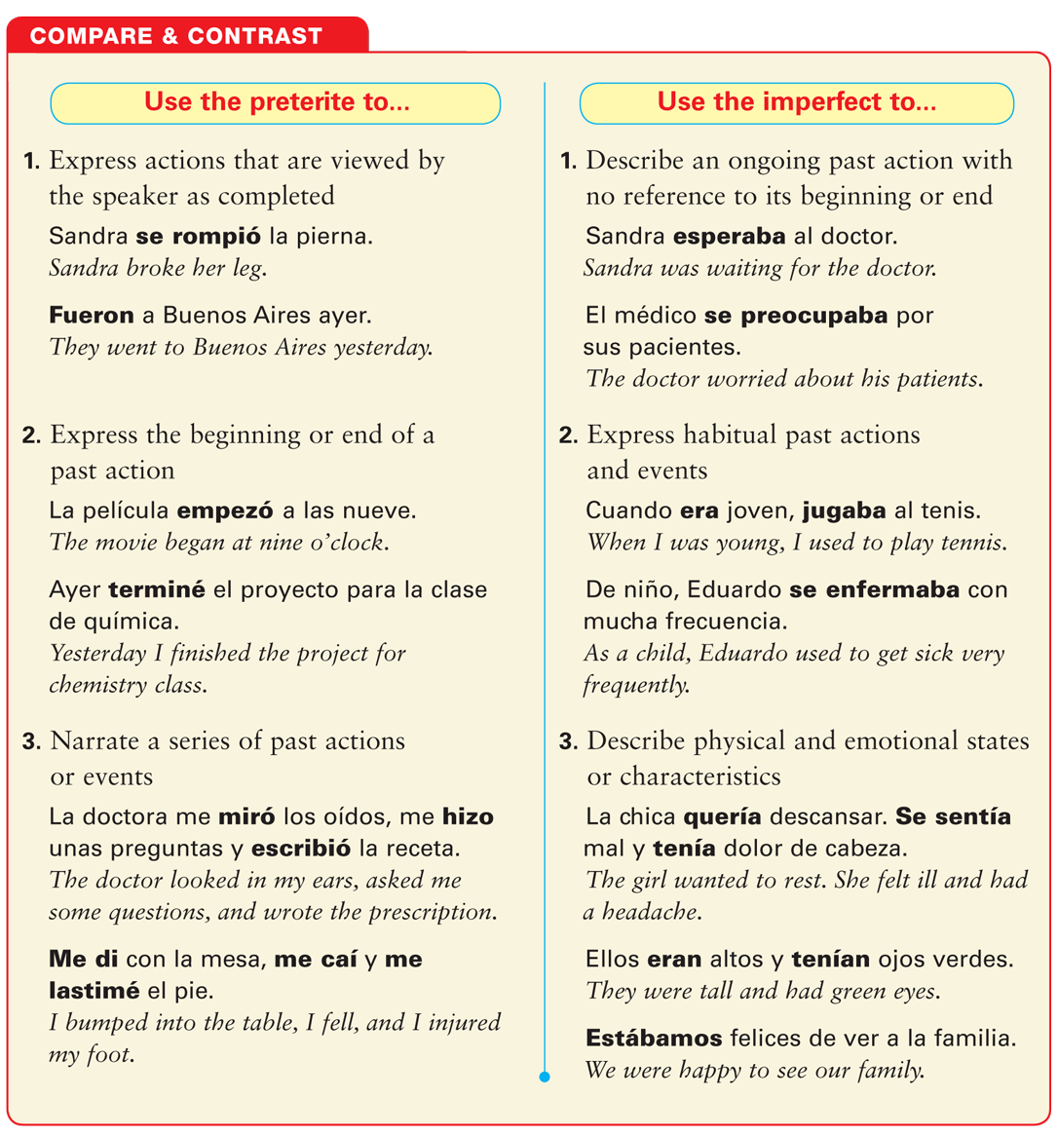
© by Vista Higher Learning, Inc. All rights reserved.
1.2-<number>

Slide 4
© by Vista Higher Learning, Inc. All rights reserved.
1.2-<number>

Slide 5
© by Vista Higher Learning, Inc. All rights reserved.
1.2-<number>

Slide 6
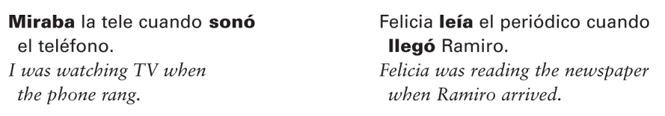
The preterite and the imperfect often appear in the same sentence. In such cases the imperfect describes what was happening, while the preterite describes the action that “interrupted” the ongoing activity.
© by Vista Higher Learning, Inc. All rights reserved.
1.2-<number>

Slide 7
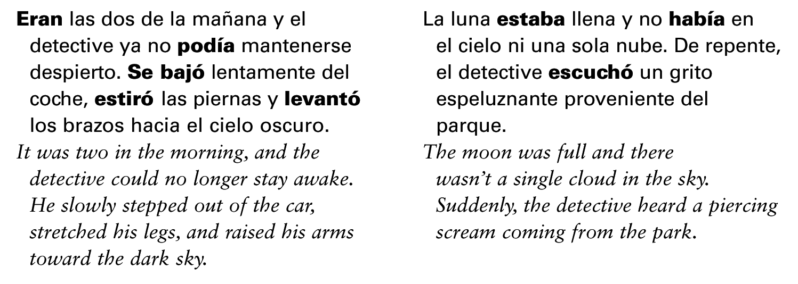
You will also see the preterite and the imperfect together in narratives such as fiction, news, and retelling of events. The imperfect provides background information, such as time, weather, and location, while the preterite indicates the specific events that occurred.
© by Vista Higher Learning, Inc. All rights reserved.
1.2-<number>

Slide 8
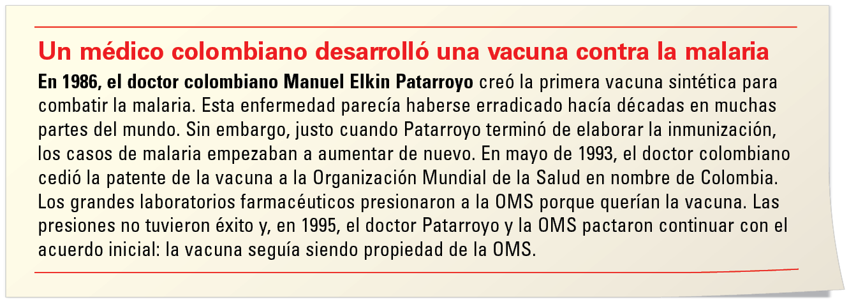
© by Vista Higher Learning, Inc. All rights reserved.
1.2-<number>

Slide 9

Elige el pretérito o el imperfecto para completar la historia. Explica por qué se usa ese tiempo verbal en cada ocasión.
_____ (Fueron/Eran) las doce. _____(Hubo/Había) mucha gente en la calle. A las doce y media, Tomás y yo _____ (entramos/entrábamos) en el restaurante Tárcoles. Todos los días yo _____ (almorcé/almorzaba) con Tomás al mediodía. El camarero _____ (llegó/llegaba) inmediatamente, para darnos el menú. Nosotros _____ (empezamos/empezábamos) a leerlo.
Eran
© by Vista Higher Learning, Inc. All rights reserved.
1.2-<number>

Slide 10
Elige el pretérito o el imperfecto para completar la historia. Explica por qué se usa ese tiempo verbal en cada ocasión. (cont.)
Yo _____ (pedí/pedía) el pescado. De repente, el camarero _____ (volvió/volvía) a nuestra mesa. Y nos _____ (dio/daba) una mala noticia. Desafortunadamente, no _____ (tuvieron/tenían) más pescado. Por eso Tomás y yo _____ (decidimos/decidíamos) comer en otro lugar. _____(Llovió/Llovía) mucho cuando _____ (salimos/salíamos) del restaurante. Así que _____ (regresamos/regresábamos) al restaurante Tárcoles. Esta vez, _____ (pedí/pedía) el arroz con pollo.
© by Vista Higher Learning, Inc. All rights reserved.
1.2-<number>

